Slide 1
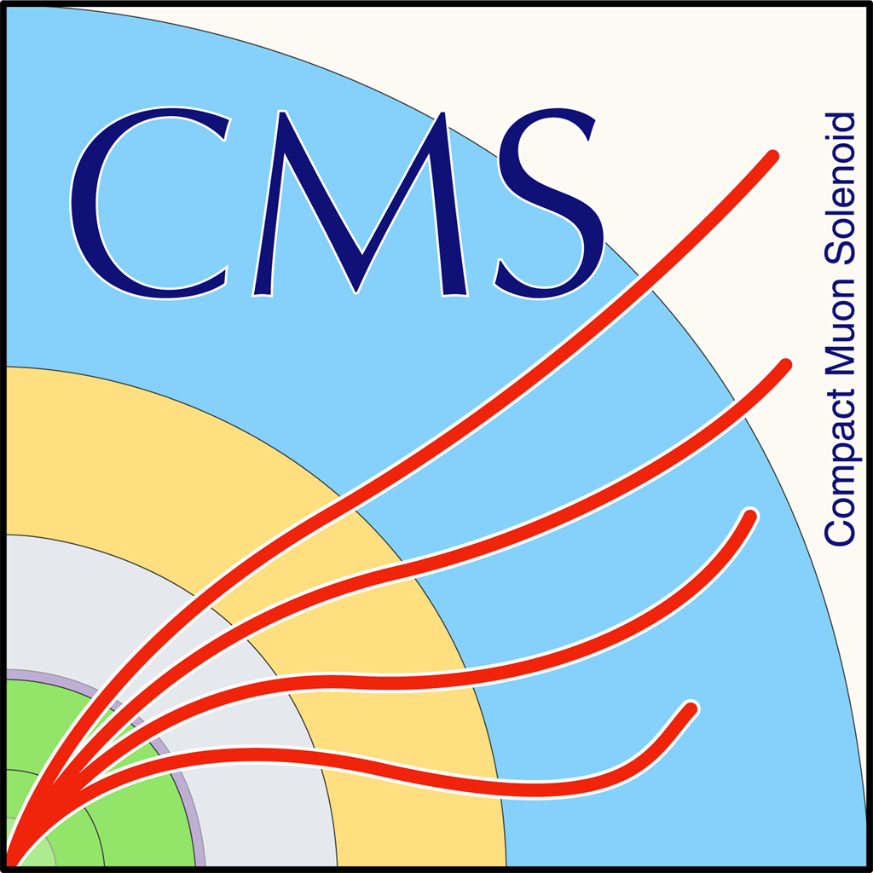

Status Report Mass Fit and bTagging Efficiency (2016,2017,2018)
George Bakas

Slide 2
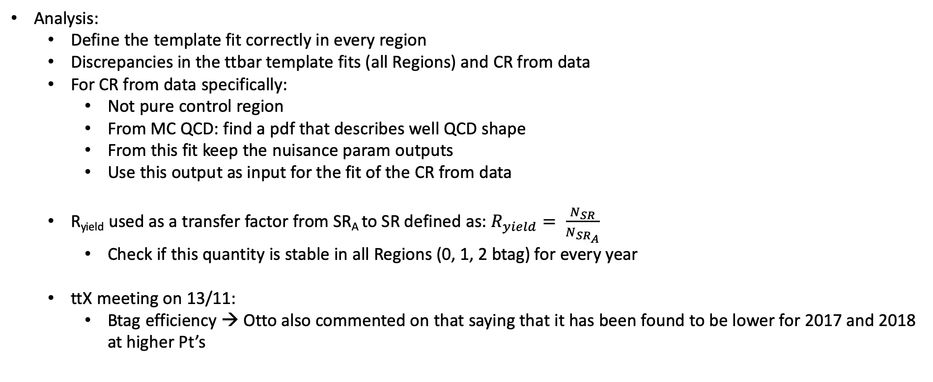
Status Report
Analysis:
Define the template fit correctly in every region
Discrepancies in the ttbar template fits (all Regions) and CR from data
For CR from data specifically:
Not pure control region
From MC QCD: find a pdf that describes well QCD shape
From this fit keep the nuisance param outputs
Use this output as input for the fit of the CR from data
R_{yield} used as a transfer factor from SR_{A} to SR defined as: $R_{yield}= \frac{N_{SR}}{N_{SR_{A}}}$
Check if this quantity is stable in all Regions (0, 1, 2 btag) for every year
ttX meeting on 13/11:
Btag efficiency → Otto also commented on that saying that it has been found to be lower for 2017 and 2018 at higher Pt’s

Slide 3
Efficiency and Acceptance for 2016, 2017 and 2018 and previous 2016 analysis

Slide 4
Efficiency and Acceptance for 2016, 2017 and 2018 with no btagging selection

Slide 5
Signal Extraction
Fitted number of QCD events in SR_{A}
Measured dist from data
QCD shape taken from Data (CR)
$$S\left(x_{reco}\right)=D\left(x_{reco}\right)−C_{bkg}^{yield}N_{QCD}^{fit}C_{QCD}^{shape}\left(x_{reco}\right)Q\left(x_{reco}\right)−B(x_{reco})$$
Fiducial Yield
Transfer factor from SR_{A} to SR
QCD shape correction factor
Subdominant bkg shape and contribution (MC)
Where x_{reco} is the respected variable of interest (ttbar mass,pt, rapidity, leading and subleading jetPt and |jetY|)
We deploy a simultaneous fit in 3 regions (0,1,2 btag) because we do not have a pure Control Region.
Our data CR is ttbar contaminated
$$D{\left(m^{t}\right)}^{(i)}=N_{tt}^{(i)}T^{(i)}\left(m^{t},k_{MassScale}, k_{MassResolution}\right)+N_{bkg}^{(i)}B\left(m^{t} \right)\left(1+k_{1}x\right)+N_{sub}^{(i)}O^{(i)}\left(m^{t}\right)$$
We assume that $N_{tt}^{(0)}={\left(1−e_{b}\right)}^{2}N_{tt}, N_{tt}^{(2)}=e_{b}^{2}N_{tt} and N_{tt}^{(1)}=2\left(1−e_{b}\right)e_{b}N_{tt}$ where e_{b} is the b tagging efficiency and N_{tt} is the total ttbar yield.

Slide 6
2016
Template fit results Signal Region A
1btag region
0btag region
2btag region
2017

Slide 7
Template fit results Signal Region A
2018
1btag region
0btag region
2btag region

Slide 8
Simultaneous Fit in 3 regions for 2016, 2017, 2018 when eb is free (SR)
Signal Region (2btag) (2016)
Signal Region (2btag) (2017)
Signal Region (2btag) (2018)
Result of the simultaneous fit on data in SR. The red line shows the ttbar contribution, the green line shows the QCD, and the black line shows the subdominant backgrounds

Slide 9
Simultaneous Fit in 3 regions for 2016, 2017, 2018 when eb is free (CR)
Control Region (0btag) (2016)
Control Region (0btag) (2017)
Control Region (0btag) (2018)
Result of the simultaneous fit on data in CR. The red line shows the ttbar contribution, the green line shows the QCD, and the black line shows the subdominant backgrounds

Slide 10
Simultaneous Fit in 3 regions for 2016, 2017, 2018 when eb is free (1btag region)
1btag region (2016)
1btag region (2017)
1btag region (2018)
Result of the simultaneous fit on data in 1btag region. The red line shows the ttbar contribution, the green line shows the QCD, and the black line shows the subdominant backgrounds

Slide 11
Simultaneous Fit in 3 regions for 2016 ,2017 and 2018 (nuisances) with free eb
2016
2017
2018
Floating Parameter FinalValue +/- Error
-------------------- --------------------------
btagEff 6.0786e-01 +/- 1.53e-02
kMassResol 9.5079e-01 +/- 2.42e-02
kMassScale 1.0009e+00 +/- 1.76e-03
kQCD_1b 6.0406e-03 +/- 5.05e-04
kQCD_2b 9.6764e-02 +/- 6.83e-02
nFitBkg_0b 4.5268e+03 +/- 6.84e+02
nFitBkg_1b 1.9110e+03 +/- 3.13e+02
nFitBkg_2b 1.9415e+02 +/- 2.48e+01
nFitQCD_0b 8.8132e+04 +/- 4.48e+02
nFitQCD_1b 3.0796e+04 +/- 4.61e+02
nFitQCD_2b 3.0802e+03 +/- 1.45e+02
nFitSig 1.4153e+04 +/- 7.33e+02
qcd_b0 6.6661e-01 +/- 5.74e-01
qcd_b1 1.4002e+00 +/- 1.62e+00
qcd_b2 3.3898e-02 +/- 5.46e-02
qcd_b3 3.3916e-02 +/- 3.37e-02
qcd_b4 1.6260e-02 +/- 1.52e-02
qcd_f1 6.9097e-01 +/- 2.57e-02
qcd_mean 1.5055e+02 +/- 1.05e+00
qcd_sigma 3.3739e+01 +/- 1.30e+00
Floating Parameter FinalValue +/- Error
-------------------- --------------------------
btagEff 5.4097e-01 +/- 1.39e-02
kMassResol 1.0289e+00 +/- 3.03e-02
kMassScale 9.8332e-01 +/- 2.06e-03
kQCD_1b 4.2097e-03 +/- 3.15e-04
kQCD_2b 1.5460e-02 +/- 5.16e-03
nFitBkg_0b 4.0852e+03 +/- 5.03e+02
nFitBkg_1b 1.6992e+03 +/- 2.84e+02
nFitBkg_2b 2.1330e+02 +/- 4.44e+01
nFitQCD_0b 1.5483e+05 +/- 5.41e+02
nFitQCD_1b 3.7067e+04 +/- 4.57e+02
nFitQCD_2b 2.4652e+03 +/- 1.32e+02
nFitSig 1.5594e+04 +/- 7.87e+02
qcd_b0 5.2866e-01 +/- 8.49e-02
qcd_b1 1.1003e+00 +/- 1.63e-01
qcd_b2 8.4662e-02 +/- 3.49e-02
qcd_b3 5.5285e-02 +/- 1.06e-02
qcd_b4 1.9483e-02 +/- 3.70e-03
qcd_f1 7.1106e-01 +/- 1.24e-02
qcd_mean 1.5184e+02 +/- 6.37e-01
qcd_sigma 3.2820e+01 +/- 6.76e-01
Floating Parameter FinalValue +/- Error
-------------------- --------------------------
btagEff 5.7371e-01 +/- 1.12e-02
kMassResol 1.0251e+00 +/- 2.43e-02
kMassScale 9.8728e-01 +/- 1.61e-03
kQCD_1b 3.6804e-03 +/- 2.60e-04
kQCD_2b 1.3533e-02 +/- 3.24e-03
nFitBkg_0b 4.1842e+03 +/- 5.05e+02
nFitBkg_1b 2.1675e+03 +/- 3.15e+02
nFitBkg_2b 3.4159e+02 +/- 7.52e+01
nFitQCD_0b 1.6842e+05 +/- 5.64e+02
nFitQCD_1b 4.9321e+04 +/- 5.36e+02
nFitQCD_2b 4.4306e+03 +/- 1.77e+02
nFitSig 2.2906e+04 +/- 8.92e+02
qcd_b0 4.0935e-01 +/- 6.23e-02
qcd_b1 8.5950e-01 +/- 1.25e-01
qcd_b2 1.0234e-01 +/- 2.32e-02
qcd_b3 2.4955e-02 +/- 6.63e-03
qcd_b4 1.1844e-02 +/- 2.02e-03
qcd_f1 7.3124e-01 +/- 1.01e-02
qcd_mean 1.5274e+02 +/- 5.33e-01
qcd_sigma 3.1322e+01 +/- 6.11e-01
Ntt expected: 16351
Ntt observed: 14153
Signal strength r: 0.865584
Ntt expected: 23721
Ntt observed: 15594
Signal strength r: 0.657402
Ntt expected: 30676
Ntt observed: 22906
Signal strength r: 0.746688

Slide 12
We are checking for different values of e_{b}, the output of the N⁽²⁾_{QCD} for 2016 , 2017, 2018
The values of e_{b} are picked when the fit output is efficient
Calculated btagging efficiency for all years
btagging efficiency when the parameter is set as a free nuisance in the simultaneous fit
2016: eb (fit) ≈ 0.61 and eb (calculated) ≈0.63
2017: eb(fit) ≈ 0.55 and eb (calculated) ≈ 0.61
2018: eb(fit) ≈ 0.57 and eb (calculated) ≈ 0.63
Stable results (within error) of N⁽²⁾_{QCD} for a variety of b-tagging efficiency values
2016
2017
2018
e_{b} from fit
e_{b} from fit
e_{b} calculated
e_{b} from fit
e_{b} calculated
e_{b} calculated
e_{b} calculated

Slide 13
2016
2017
2018

Slide 14
R_{yield} Calculation
2016
2017
2018

